Slide 1
Splitly Expense Tracker
Sameer S Deshpande

Slide 2
CONTENTS
Introduction
Design & Approach
Key Features
Summary

Slide 3
INTRODUCTION
In today's world, managing personal finances can be a complex and time-consuming task. With various types of expenses, from daily purchases to group expenses shared with friends or family, it becomes difficult to track and manage everything manually. Additionally, individuals often face challenges in keeping track of currency conversions when traveling abroad or dealing with multiple currencies.

Slide 4
Key Features
Track Individual Expenses
Track Group Expenses
Currency Conversion
User Experience:
Multi-User Support and Syncing
Analytics and Reporting

Slide 5
Design & Approach

Slide 6
Architecture
Model: Represents the data structures for expenses, users, categories, etc.
View: The View layer is responsible for the UI components of the app.
View Model::The View Model acts as a bridge between the Model and View layers.

Slide 7
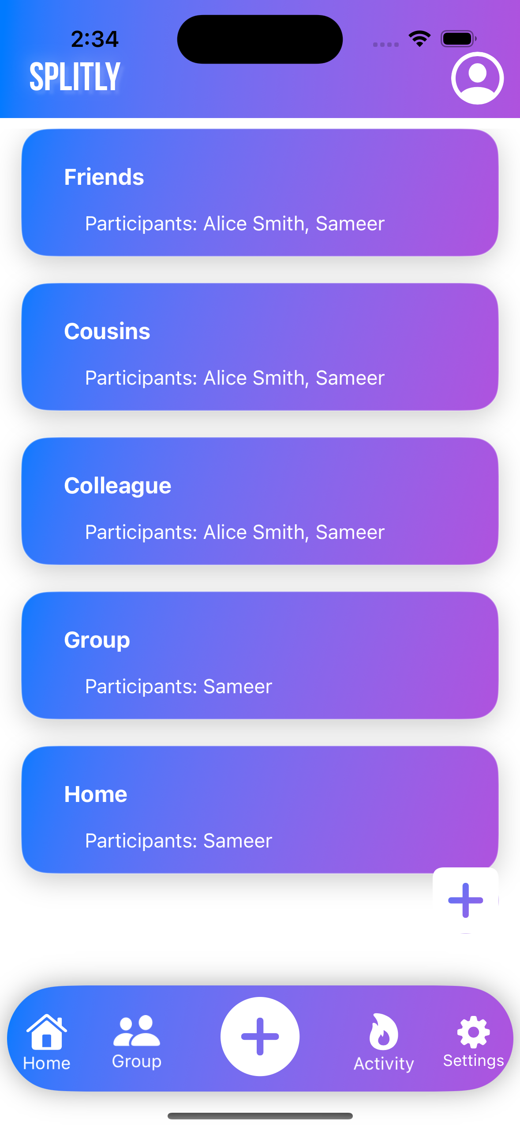
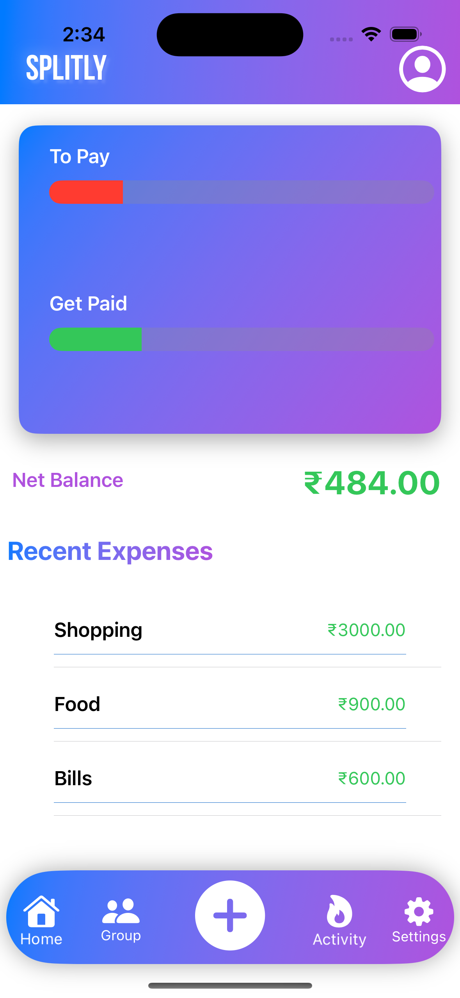
Usage of Custom tab bar, Progressive bars, Lists, icons

Slide 8
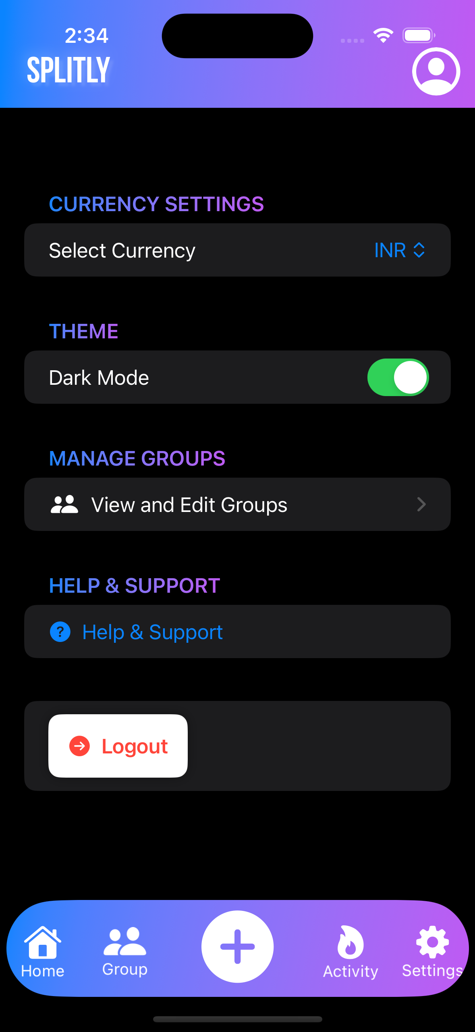
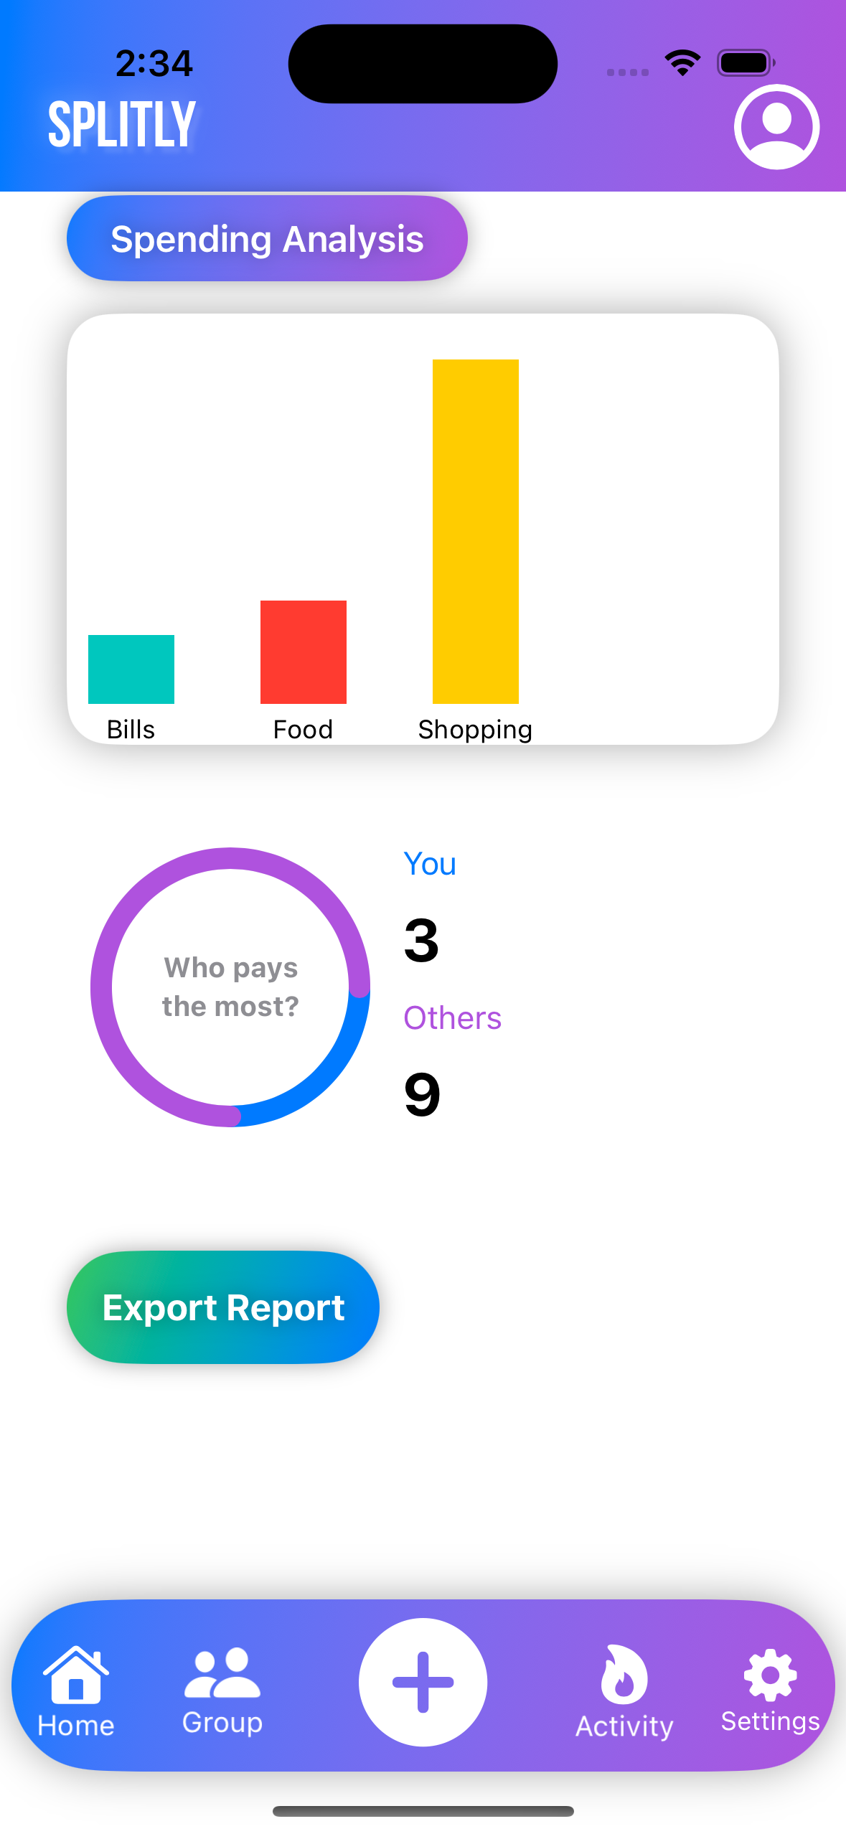
Usage of Charts, PDF Generation, Dark Mode, Currency Conversion

Slide 9
Lets talk about Tech
MVVM (Model-View-ViewModel) Database: SQLite

Slide 10
THANK YOU
Sameer S Deshpande

